Slide 1
Python Scripting at CBCL 2019
Tobias Jacobson
Summer Intern

Slide 2
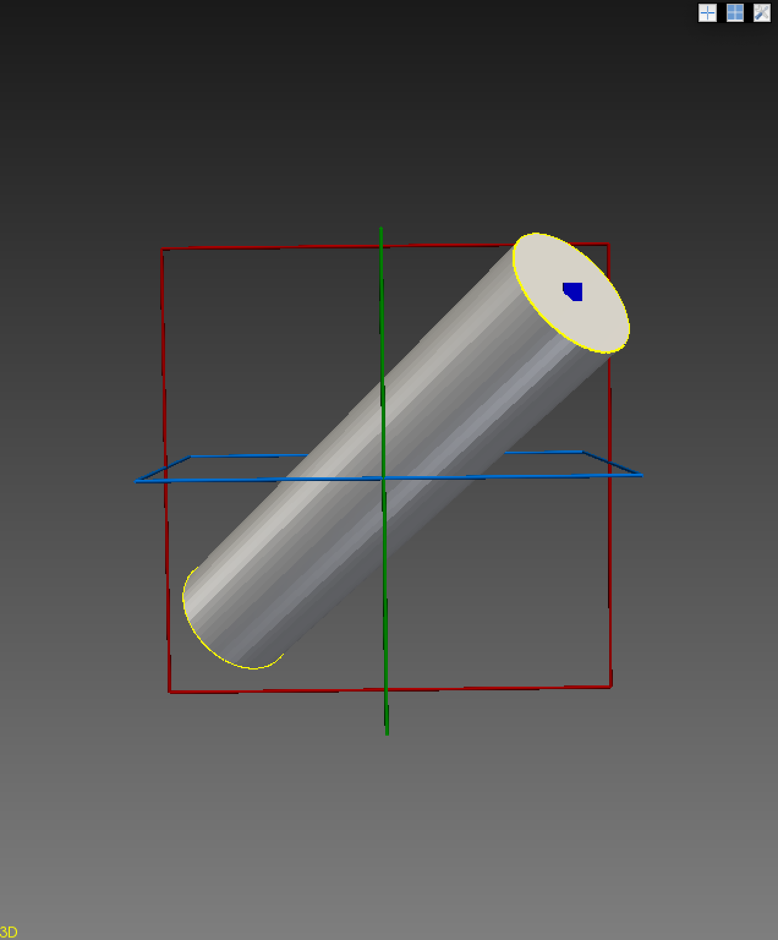
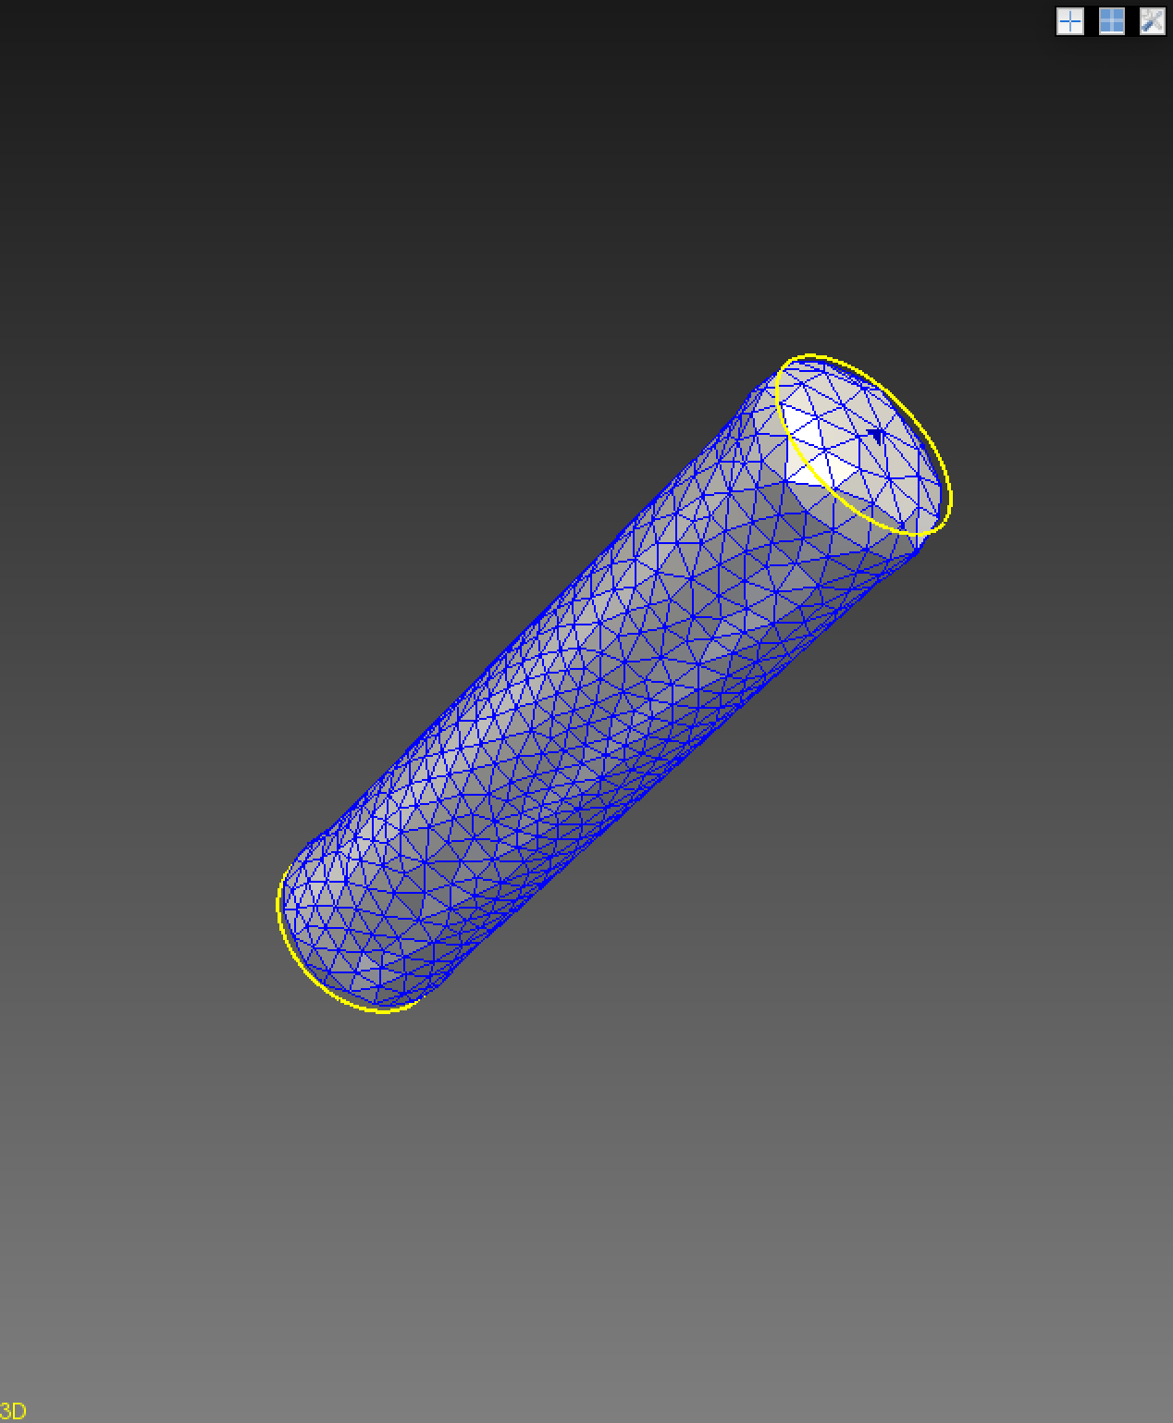
Cylinder Test Case
Generate path → mesh
Runs preSolver, solver, and svpost
Creates ‘mesh-complete’ folder → .dat, .vtp, .vtk, .vtu, .log, and restart files

Slide 3
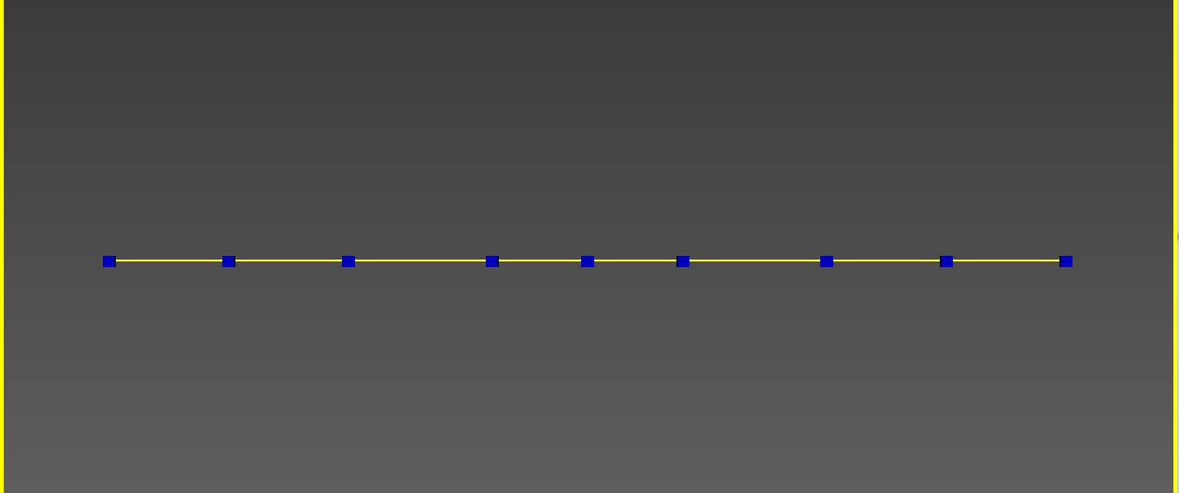
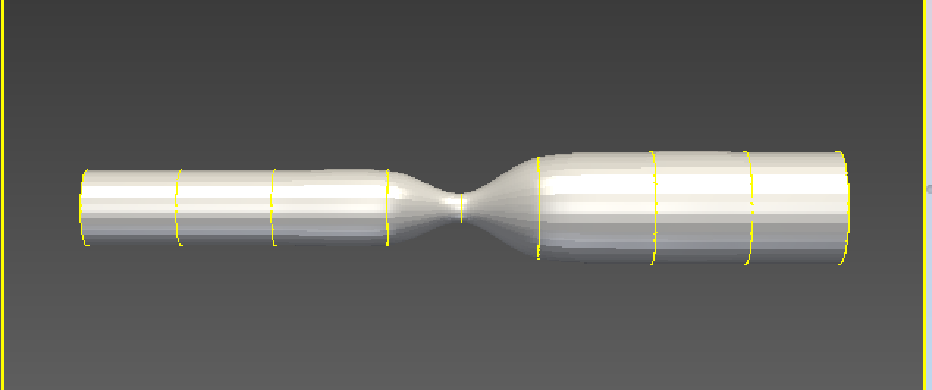
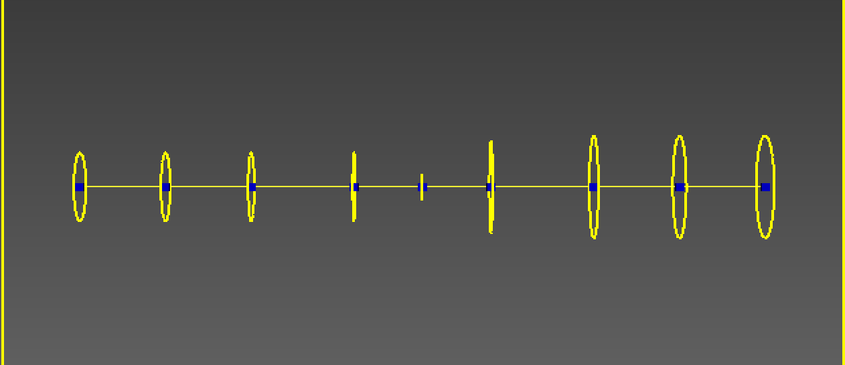
Coarct Model Scripting: Aekaansh’s Study
Coarct Pipeline function:
Inputs:
List of path points
List of radii
Outputs:
New path
New contour
New Model

Slide 4
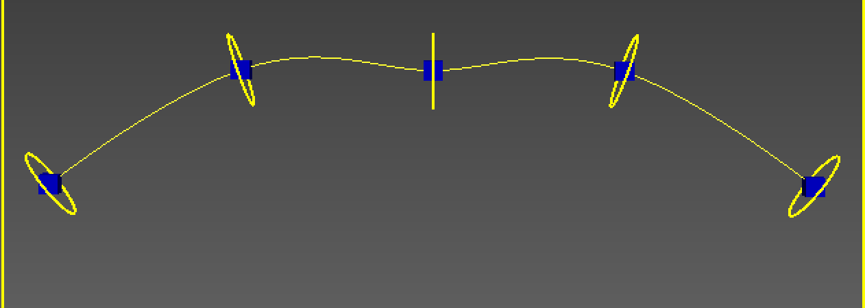
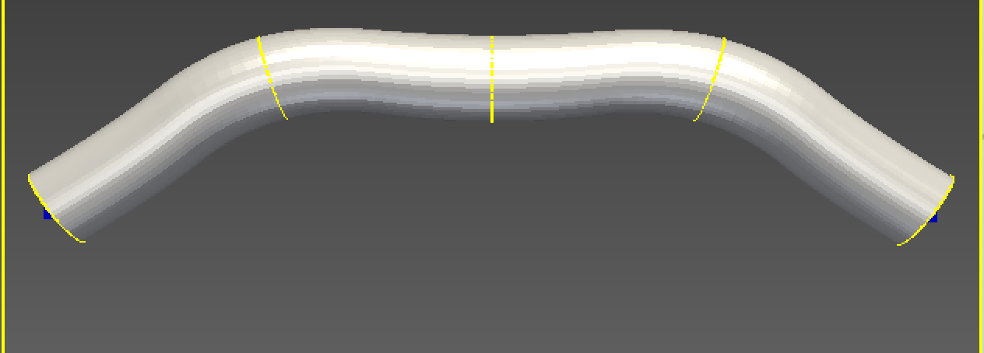
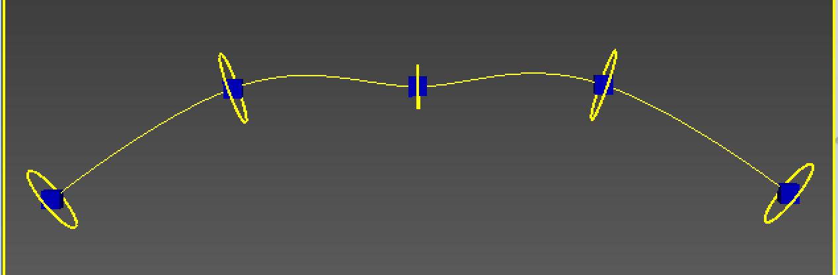
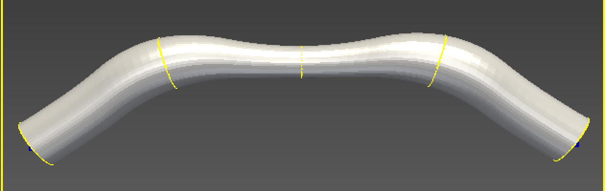
Curved coarct models with and without stenosis

Slide 5
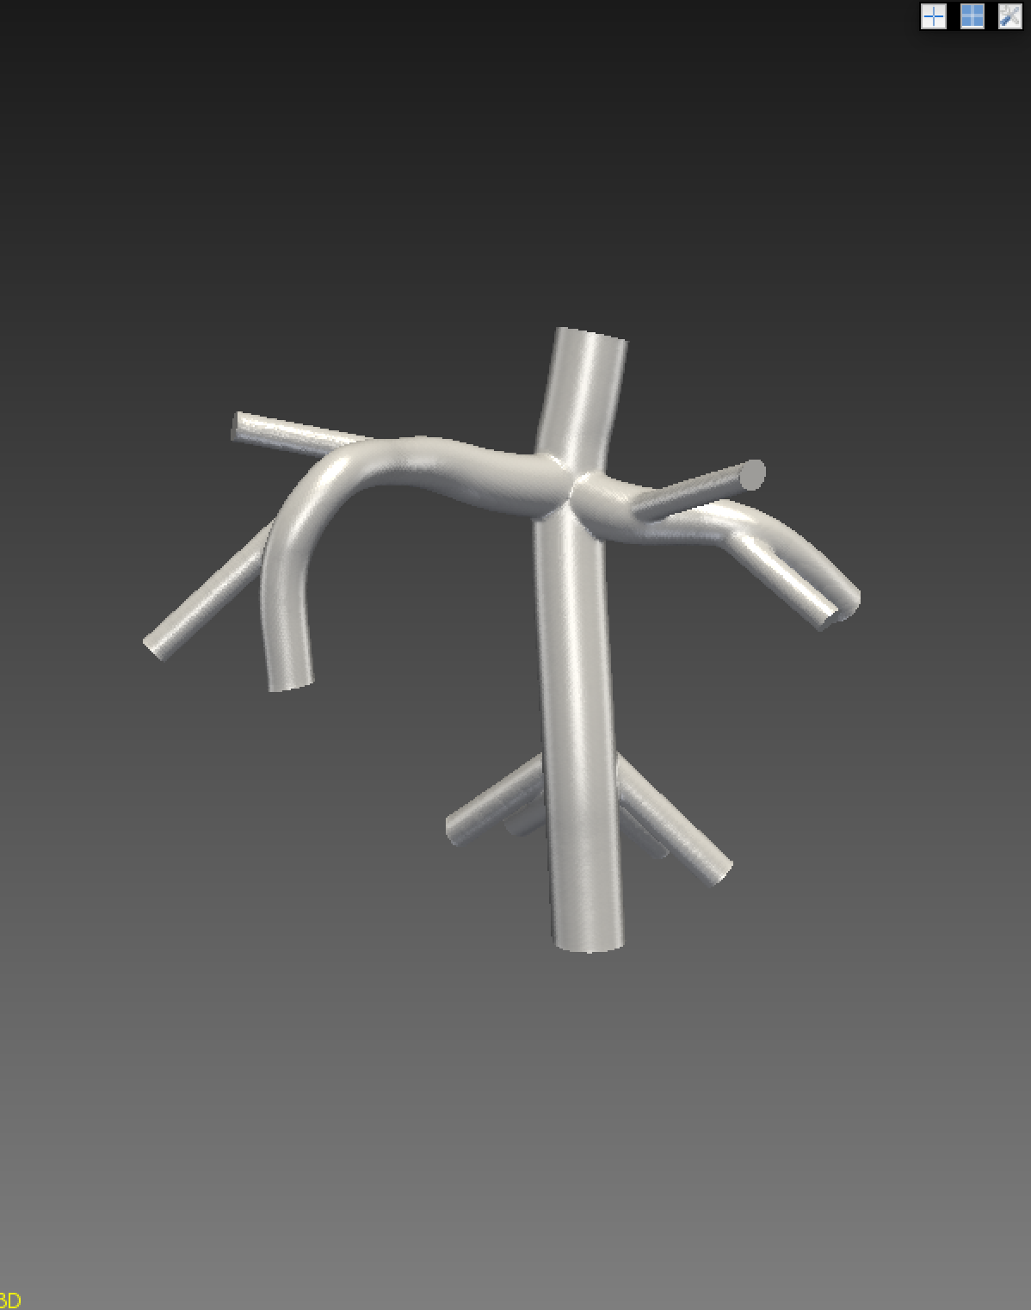
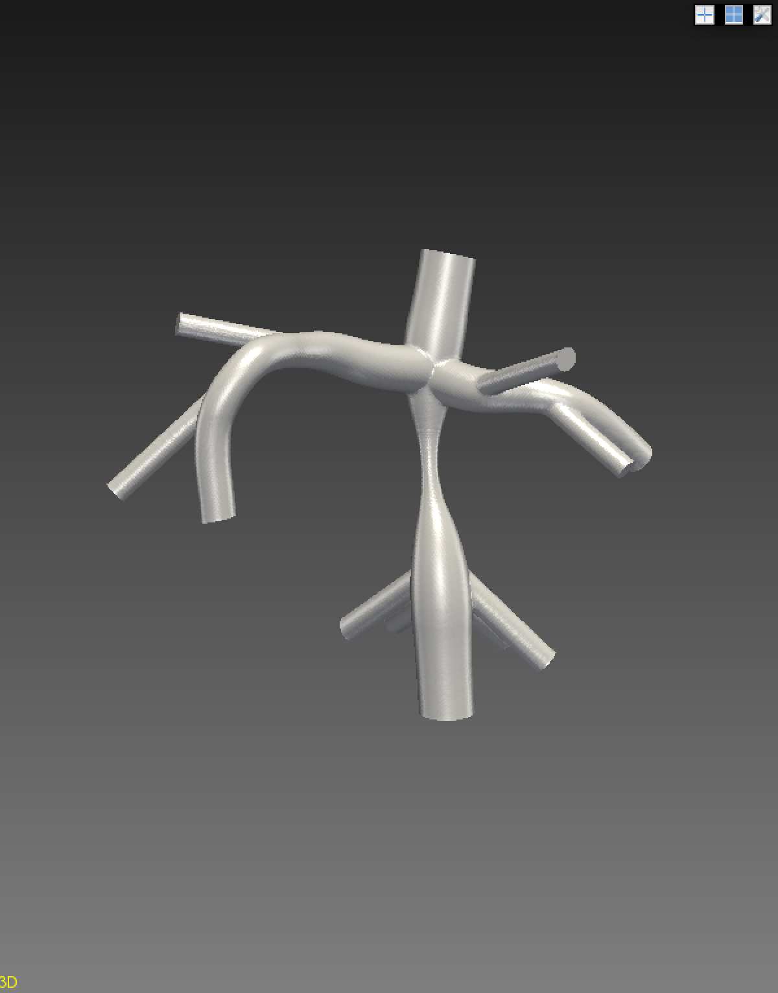
Applying Stenosis on Fontan Model: Erica’s Study

Slide 6
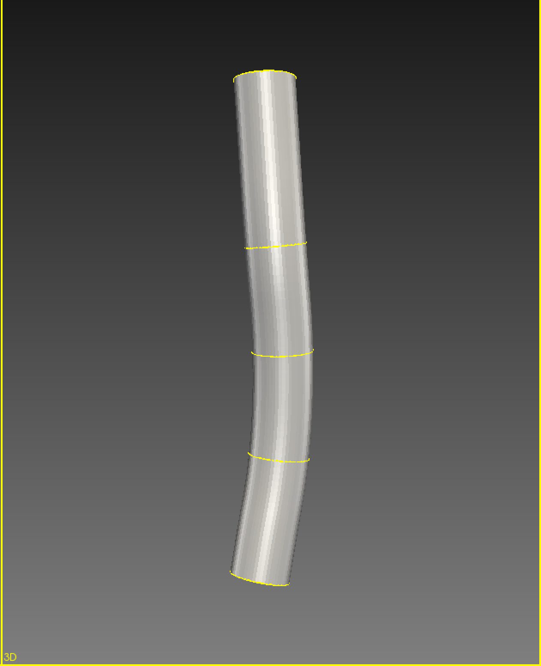
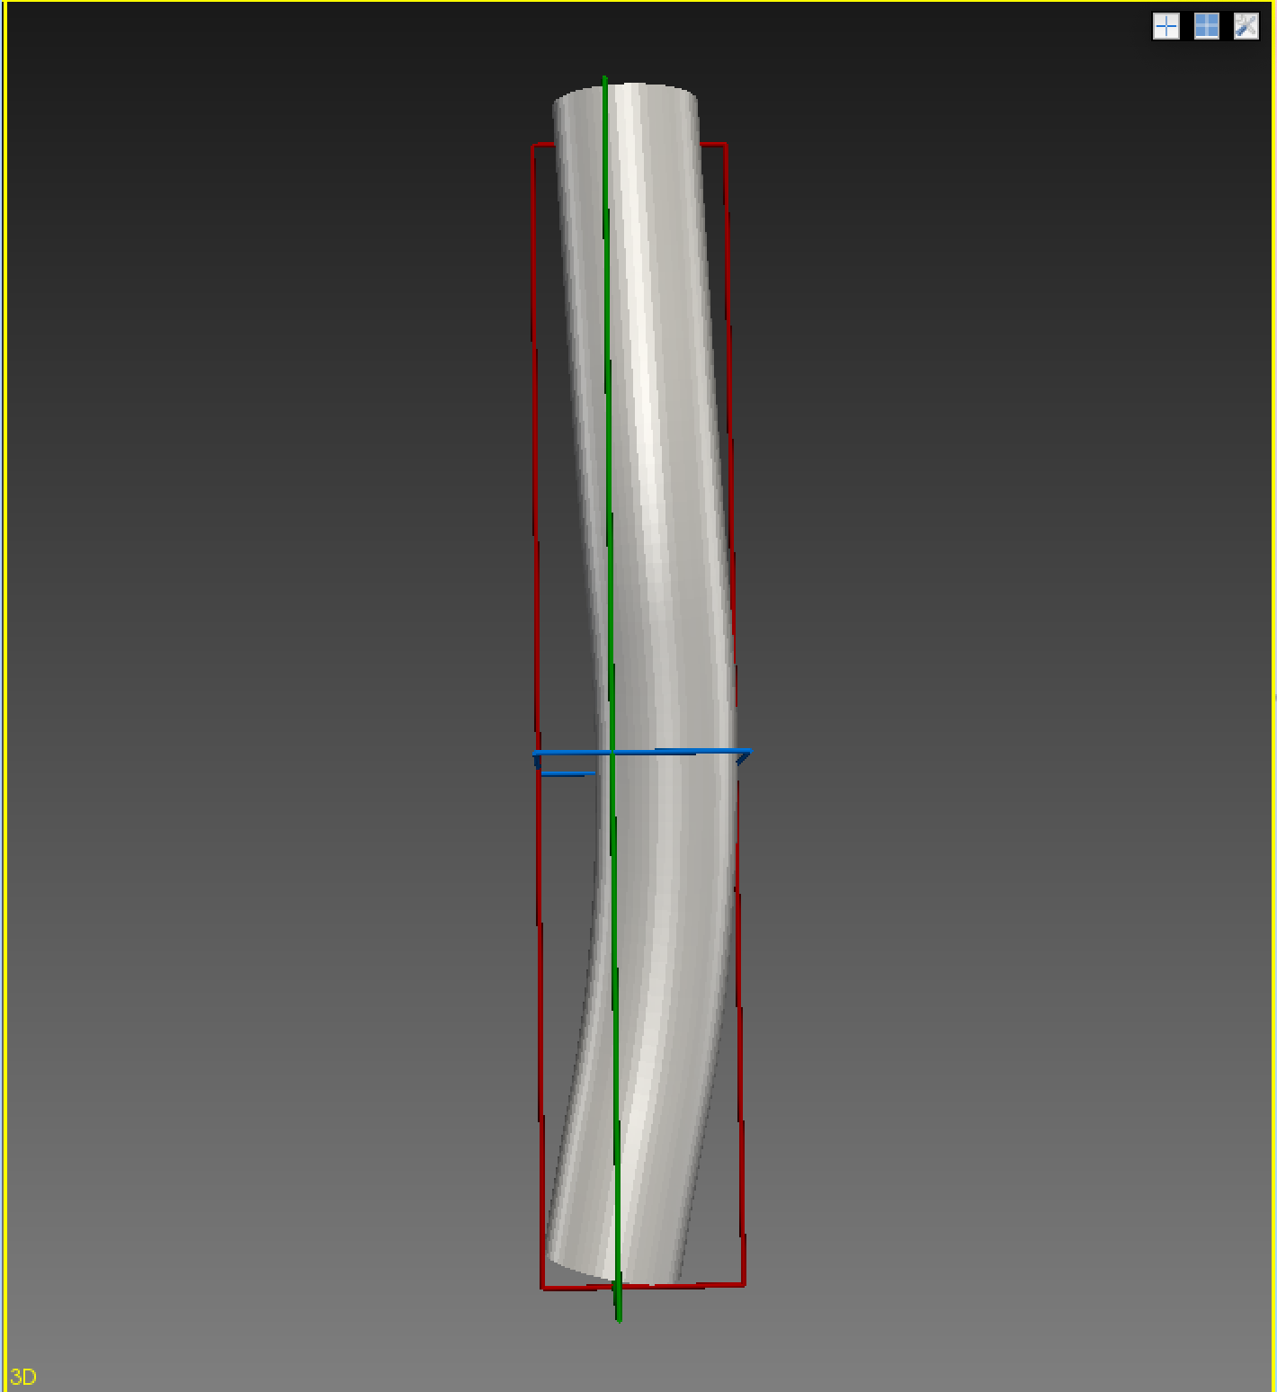
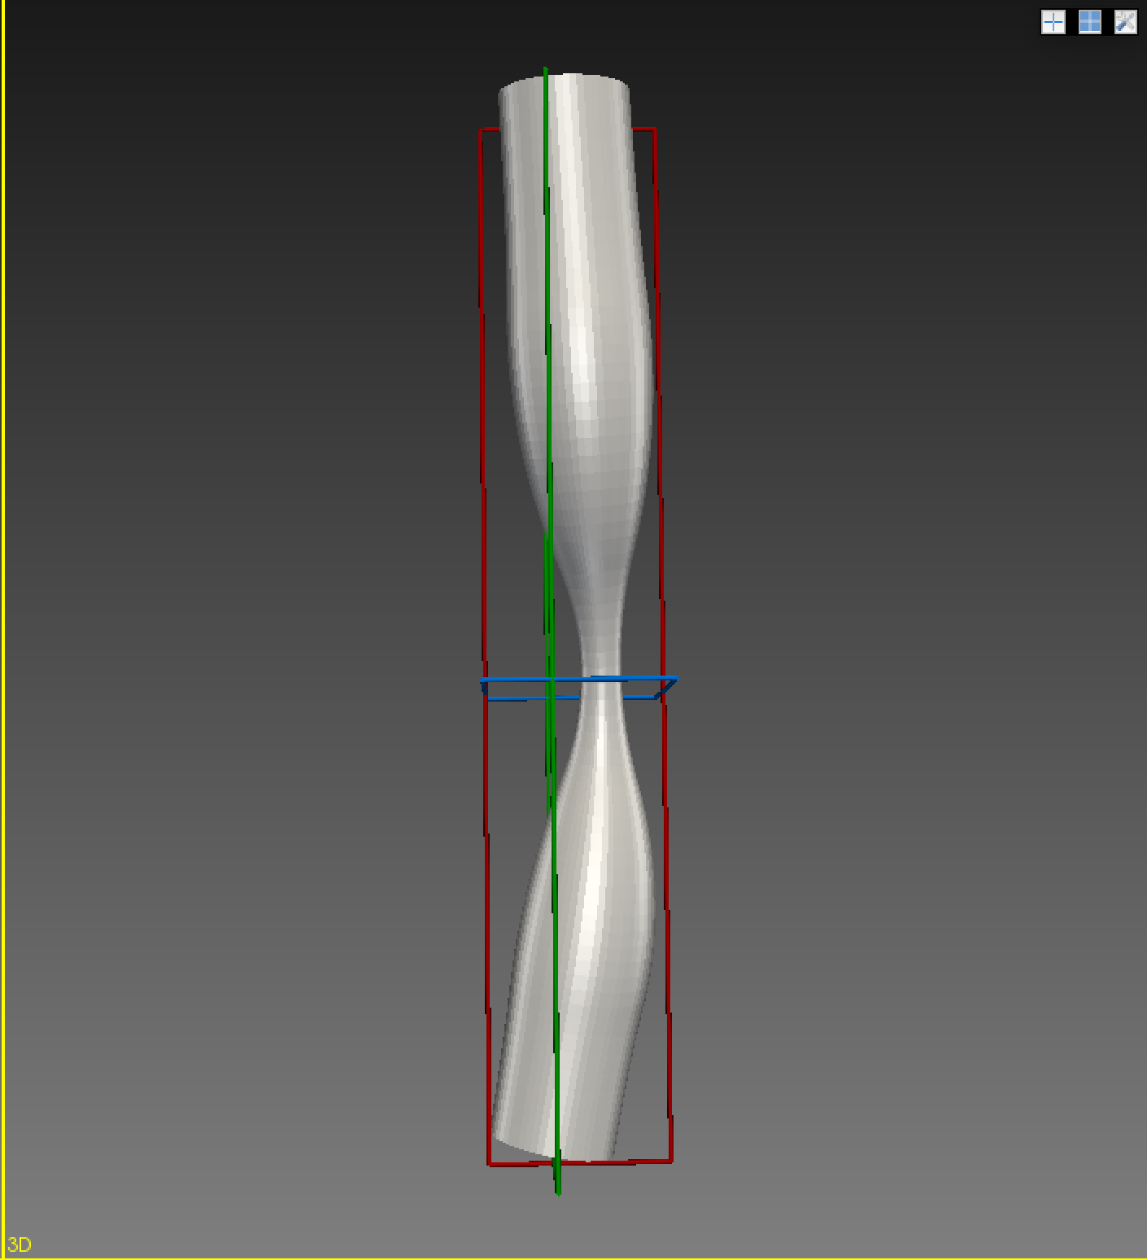
SVC Model with applied stenosis
Inputs:
SVC segment file (SVC.ctgr file)
Desired Stenosis
Contour group
Output:
Modified segment file

Slide 7
Issues with stenosis function 1.0
Had trouble collecting data from segment file
Erica helped with using Python Regex to extract:
Path point information
Radius information
Goes as: foundCenterPoints.append(re.findall(‘ “([^”]*)” ‘, text)
Limited in functionality
Only single path
Ends at new segmentation file

Slide 8
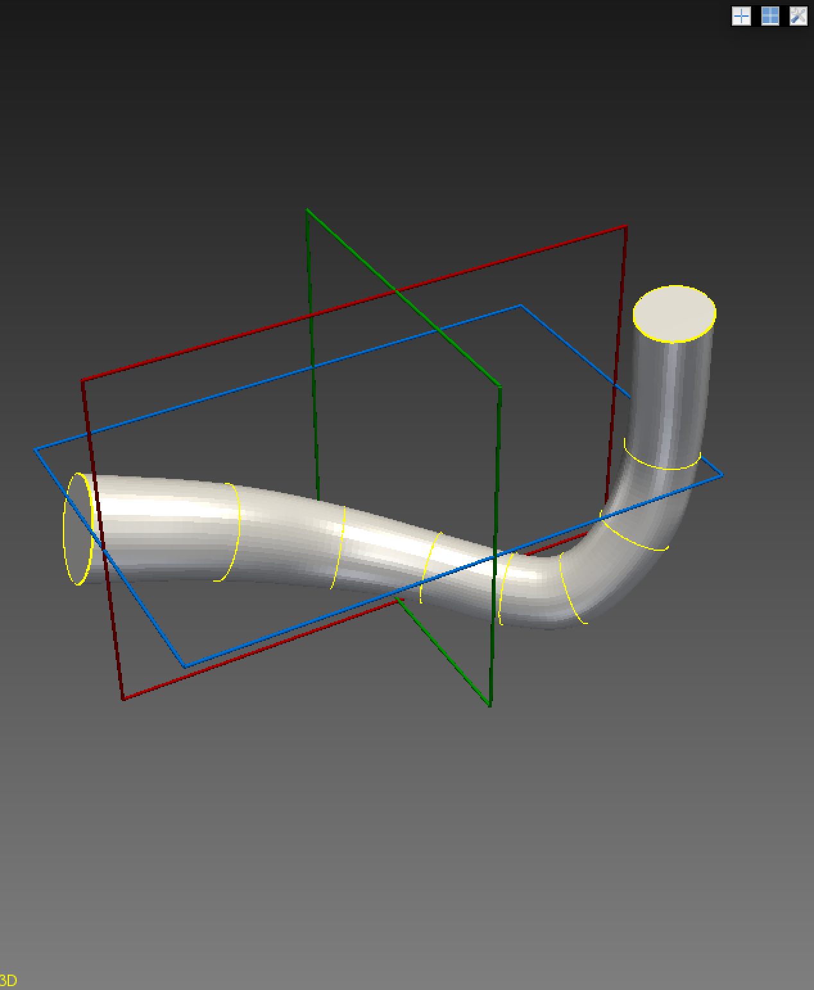
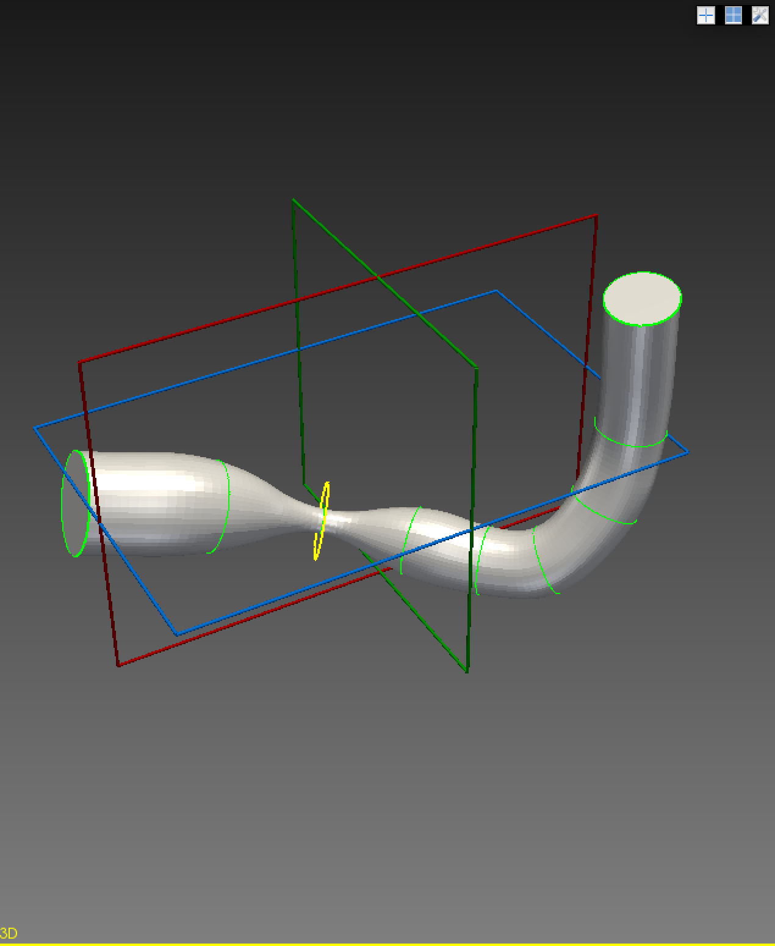
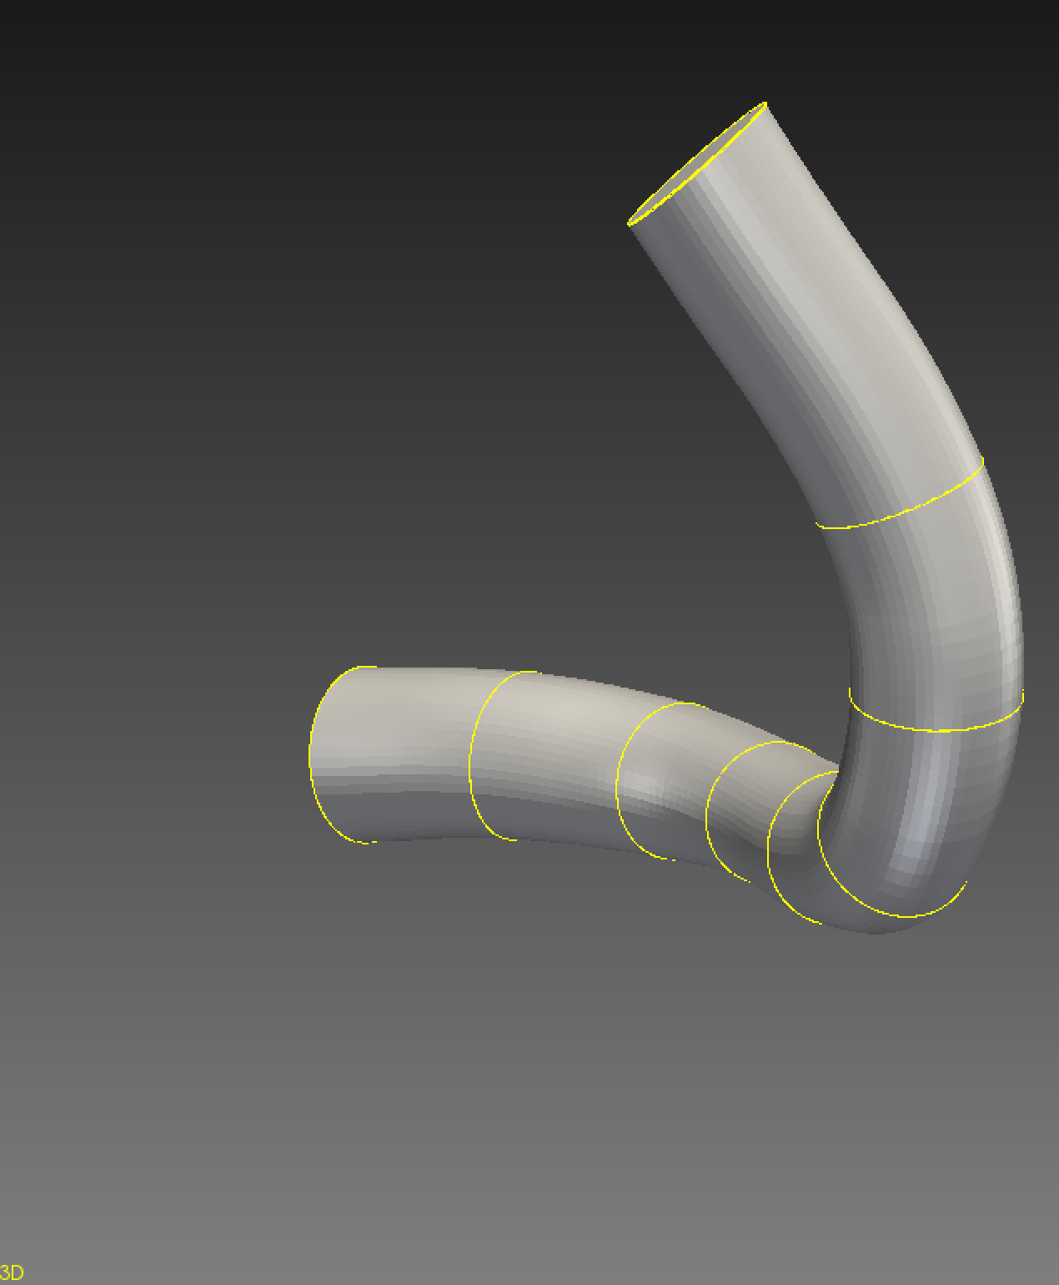
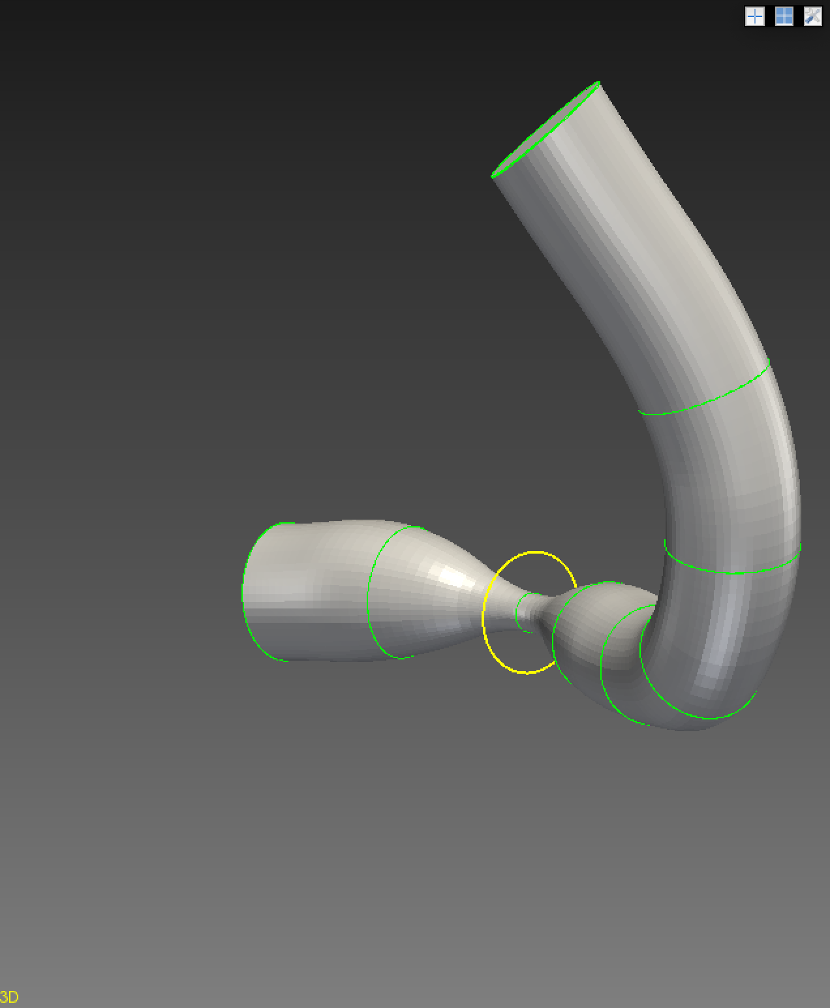
Stenosis function 2.0
Now for any segment on a model
Issues I encountered and resolved
Shifted centerline
Shifted 0 contour
Scaling was off
Examples:

Slide 9
Stenosis Pipeline 2.0
Stenosis function
Input:
Segment file
Percent Stenosis
Contour ID
Output:
Altered Segment file
Gathering points functions:
Inputs:
Altered segment file
Outputs:
List of path points
Make path function:
Inputs:
PathPoints List
New path name
New contour name
Outputs:
New path
New contour
Make contour function:
Inputs:
New contour name
New model name
Outputs:
New contour
New model
Make mesh function:
Inputs:
New vtp file name
New vtk filename
Outputs:
Vtp file
Vtk file
preSolver function:
Input:
Svpre file

Slide 10
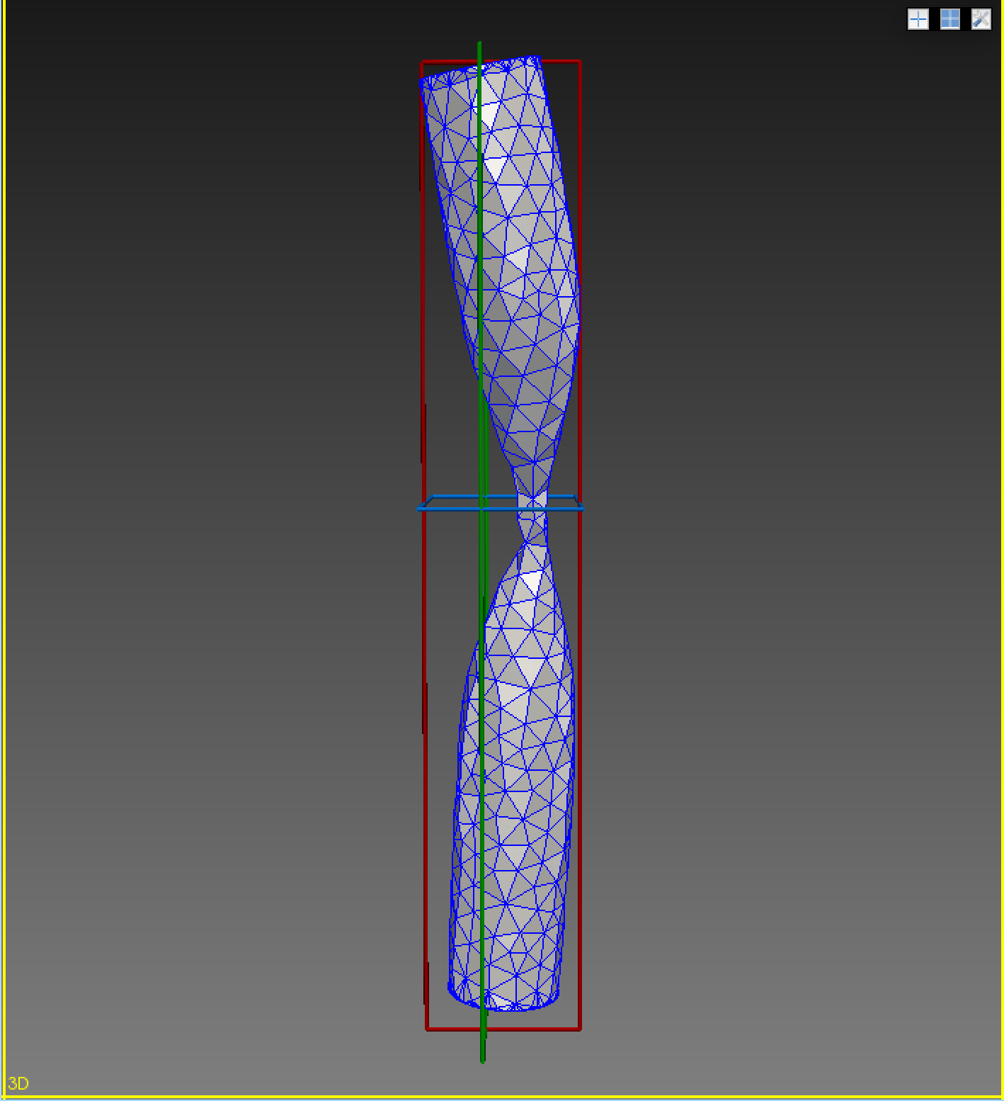
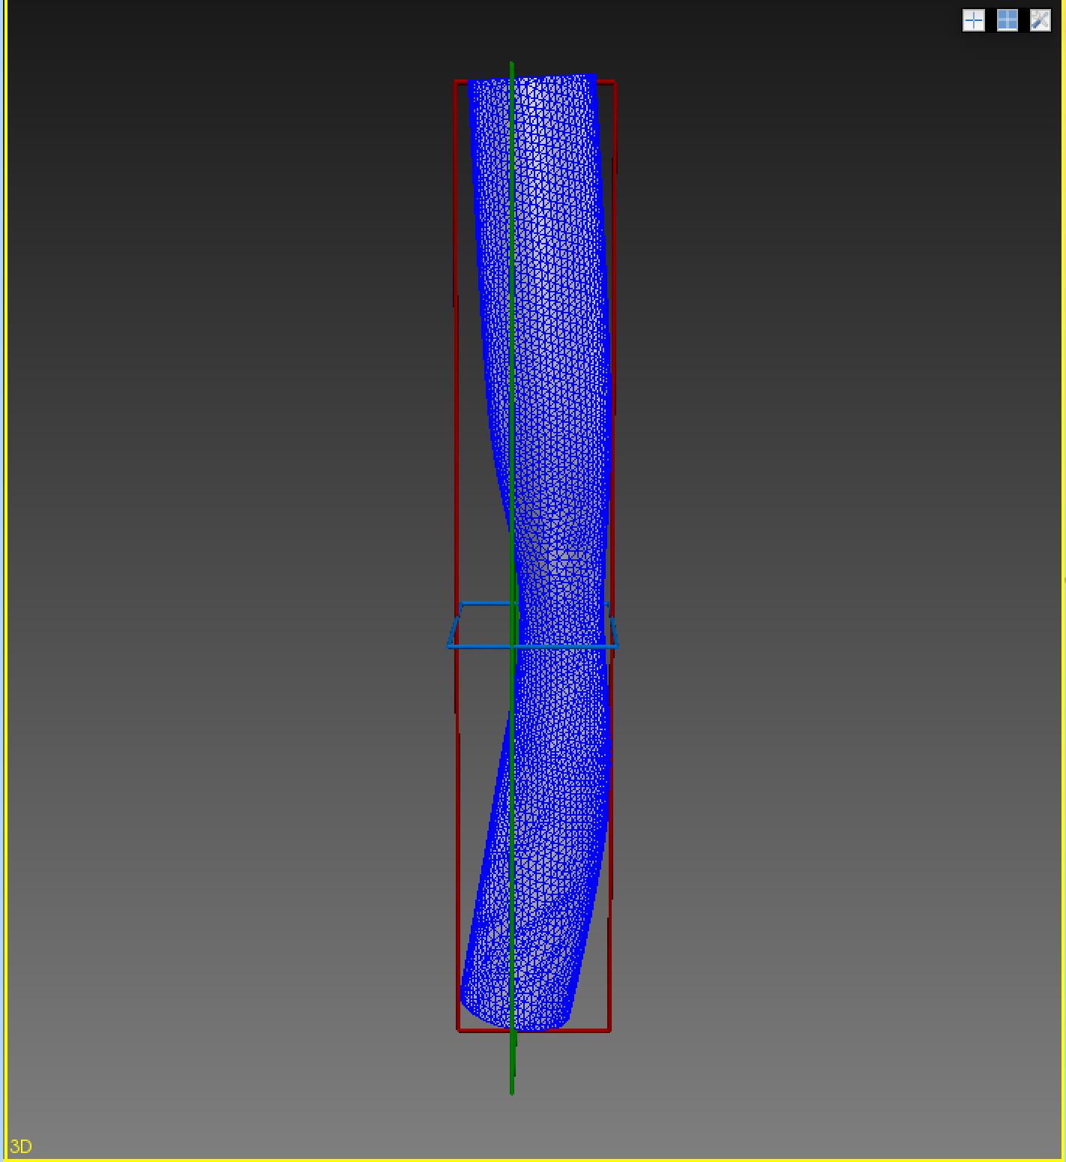
Make mesh function
Inputs:
Vtp file (existing file name)
Vtk file name (new mesh name)
Global edge size
Outputs:
Mesh complete folder

Slide 11
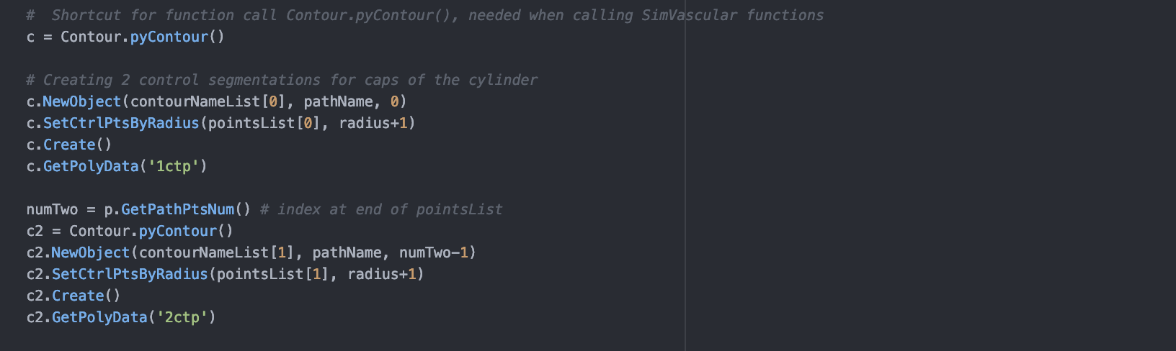
General Notes:
Stenosis Function Notes:
For contour: Decrease is calculated using area since in my case it’s always a uniform circle
Scaled using 3D matrix transformation
Zach’s python documentation helped guide me in the beginning
Issues:
Obviously encountered challenges while learning simVascular→ python console work caused simVascular to crash a lot which was annoying
Long time before I found a way to systematically create new objects (Path.pyPath & Contour.pyContour)
Making script much longer than necessary (Like 250 lines longer….)

Slide 12
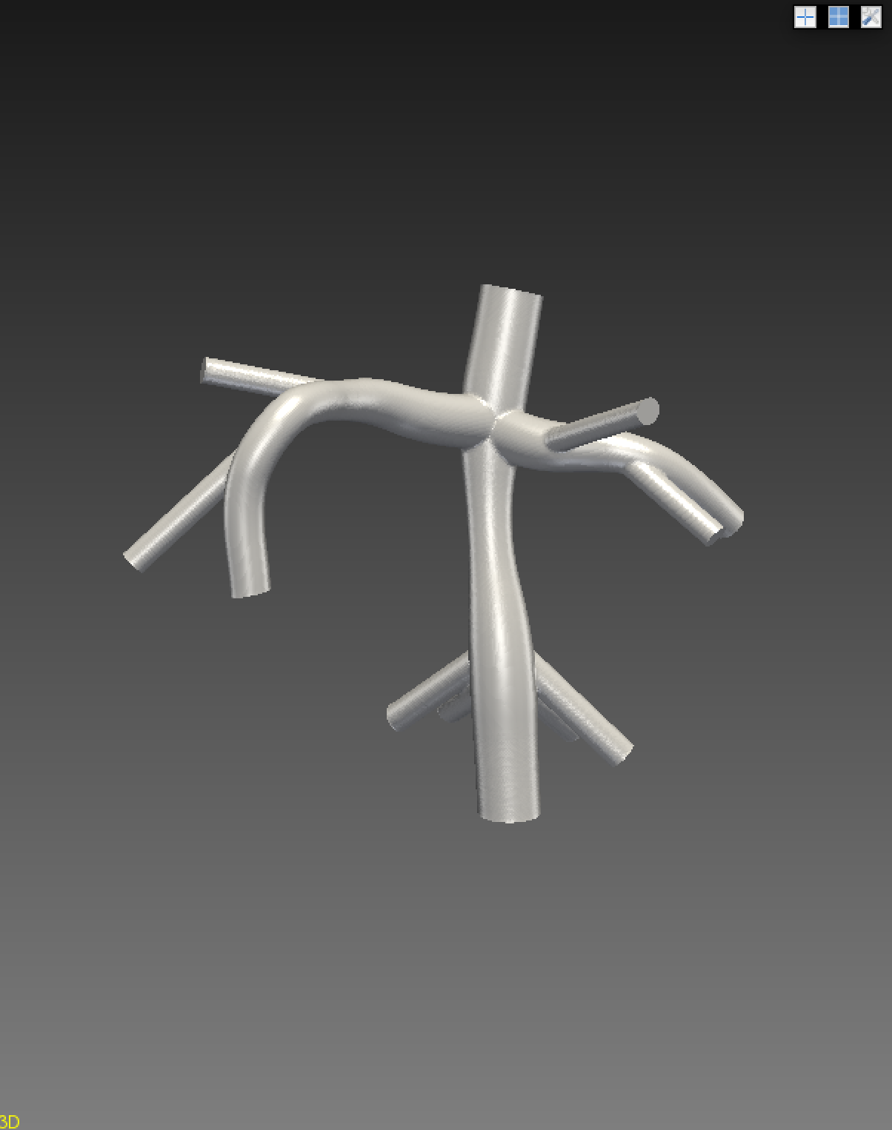
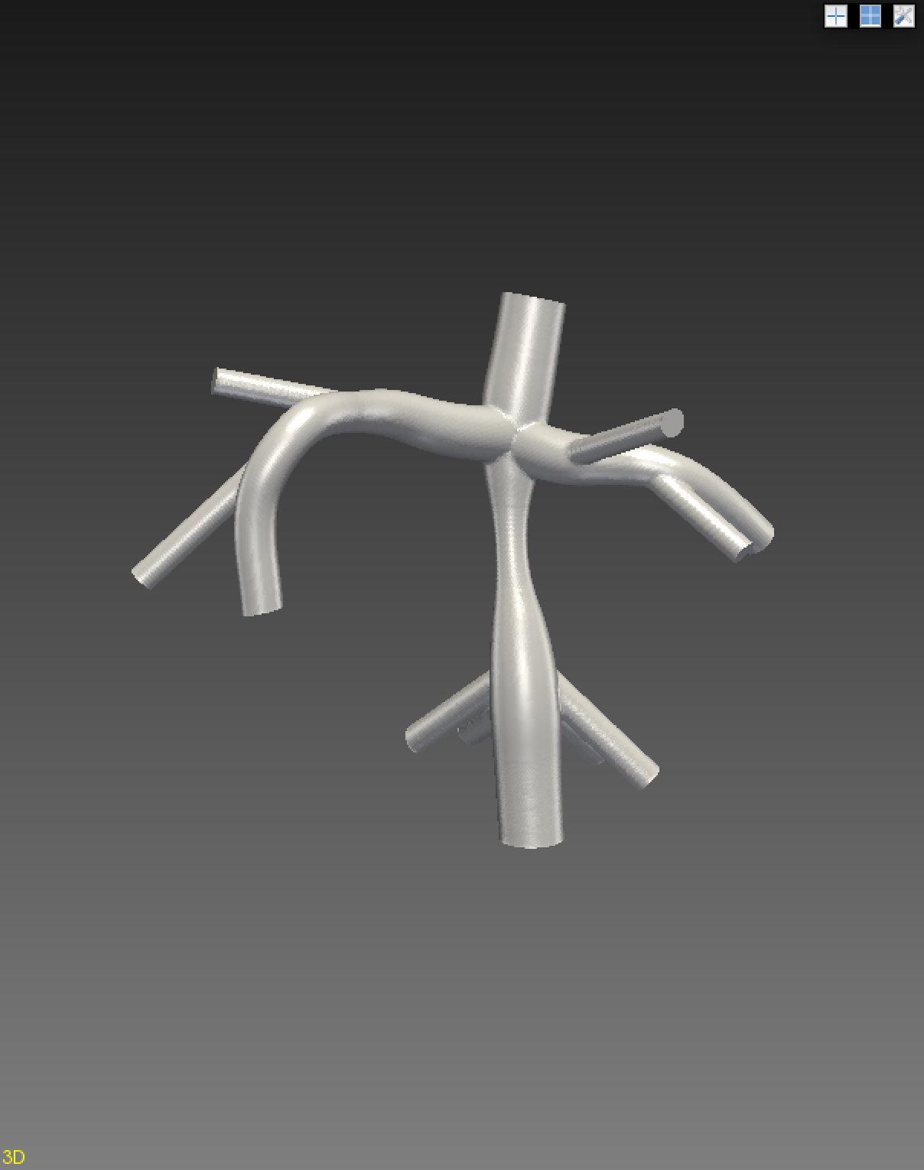
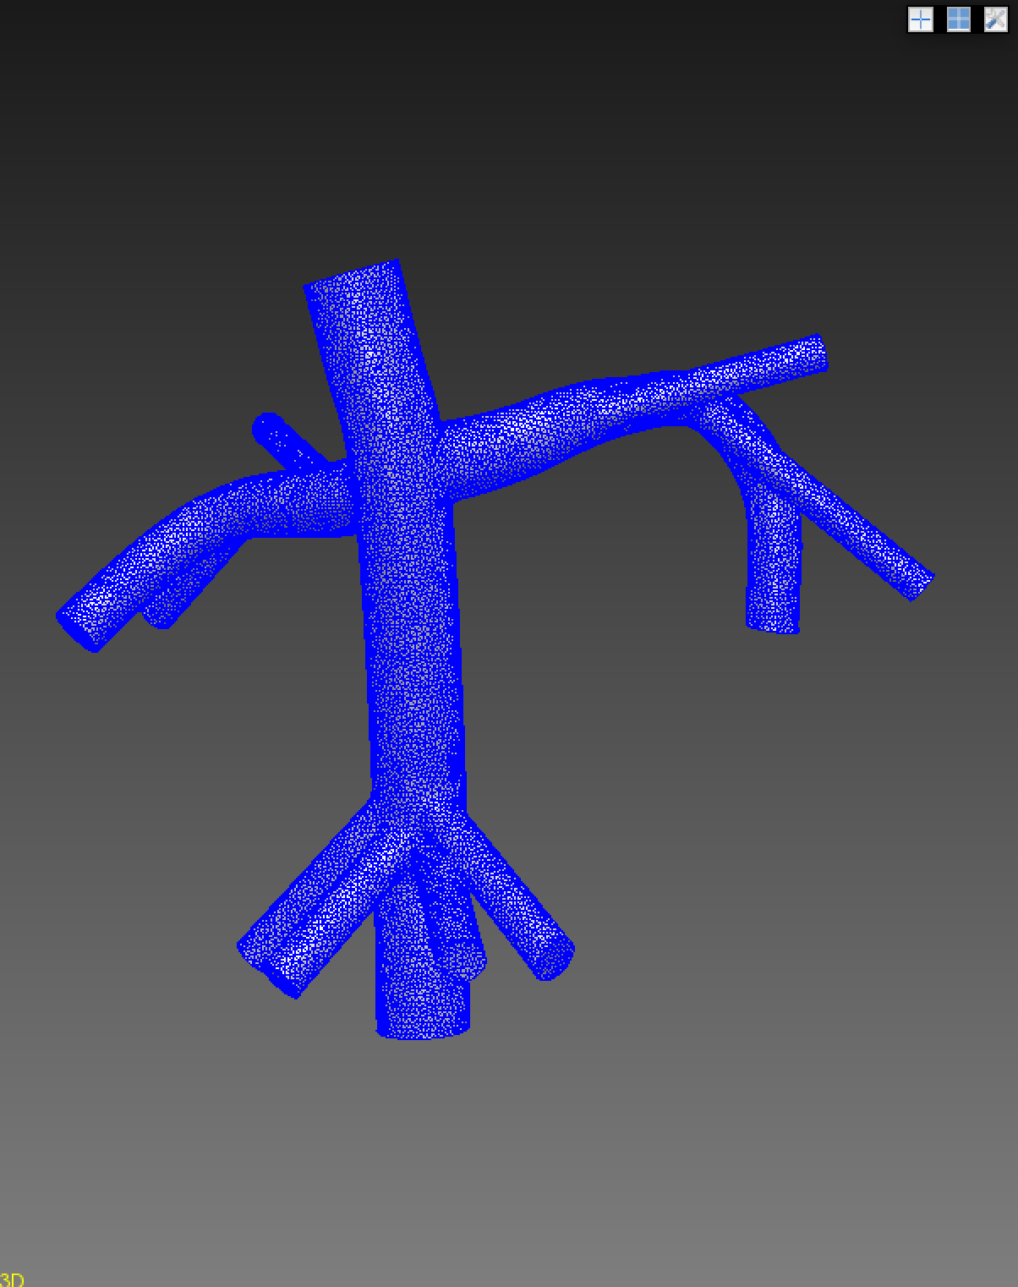
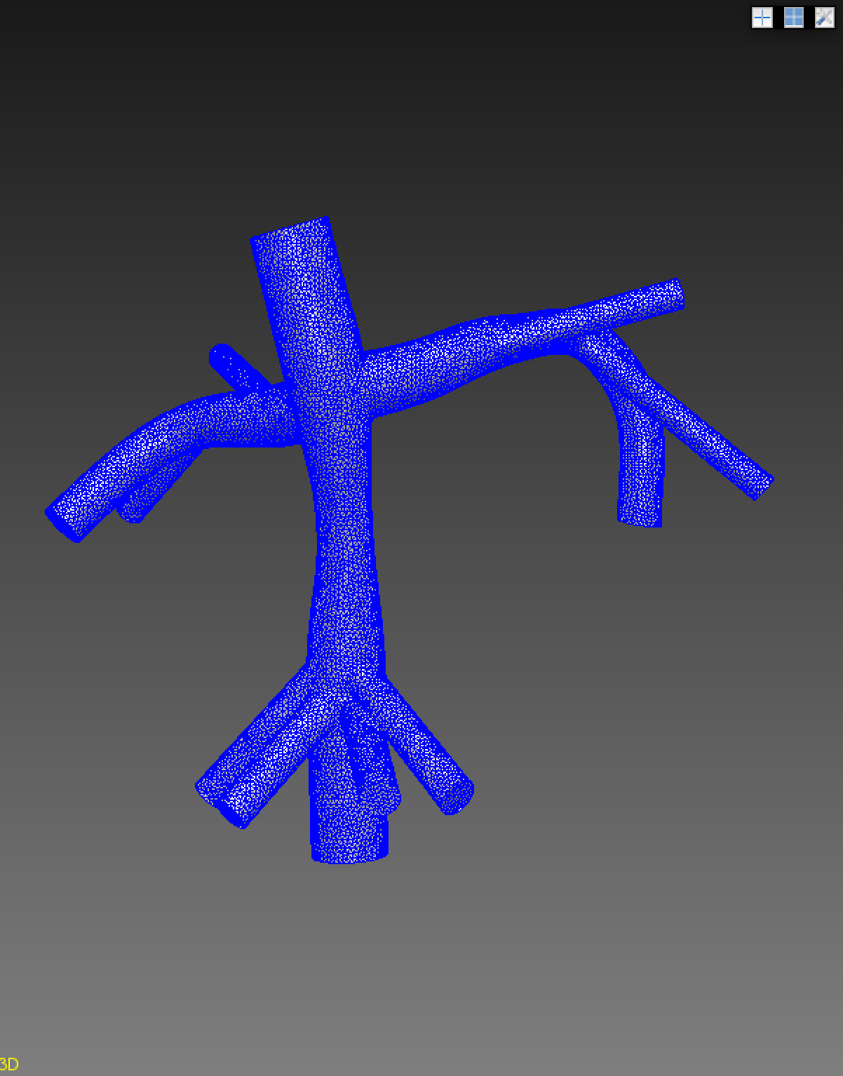
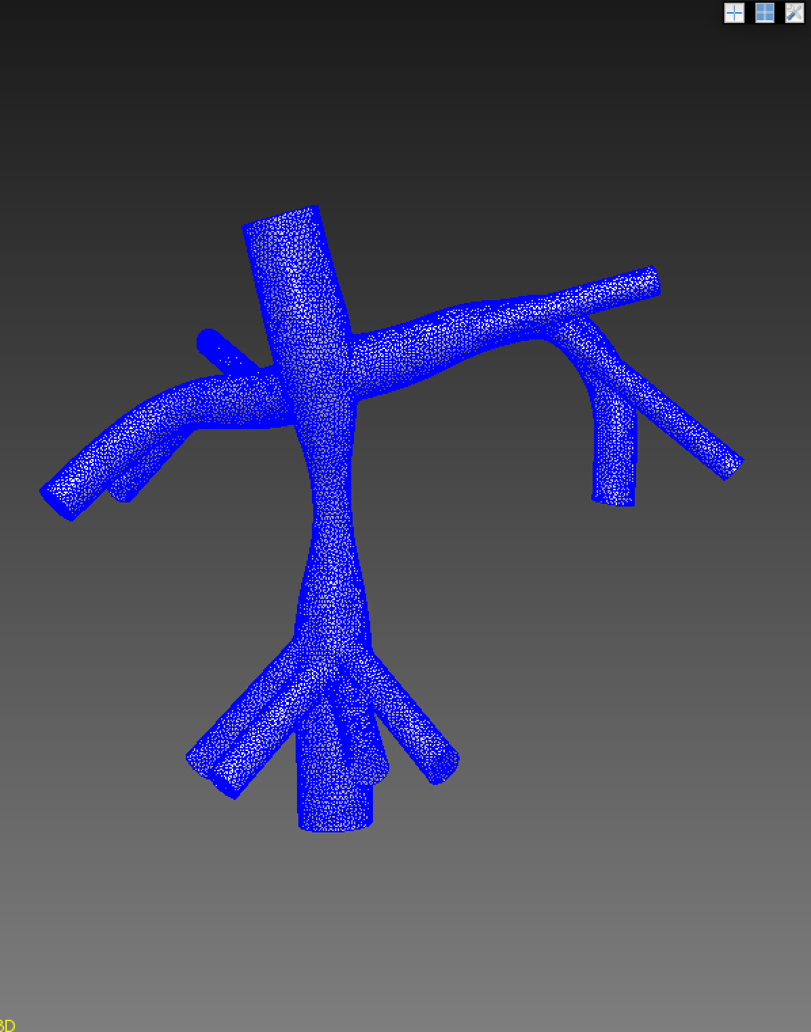

Remaining functionalities for Stenosis Pipeline
Geom.Union(itemA, itemB, destination, tolerance)

Slide 13
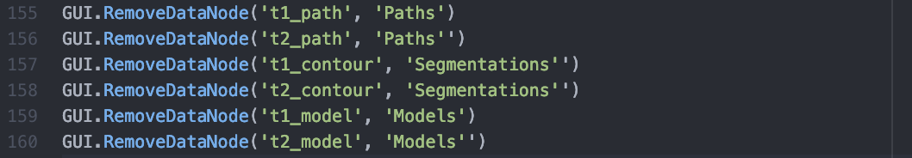
Pipeline issues that have been resolved
Run program once, then quit
Throws error ‘item already exists’
Seriously slowed progress
Update: now implemented as → GUI.RemoveDataNode('childName', ‘folderName')

Slide 14
Tcl Script Conversion: Jongmin’s Study
Difficulties encountered:
Never seen Tcl before
Tcl can’t always easily convert to python
Non-open source functionalities vs open source functionalities
Unfinished conversion
Parasolid & Tetgen vs PolyData & MeshSim

Slide 15
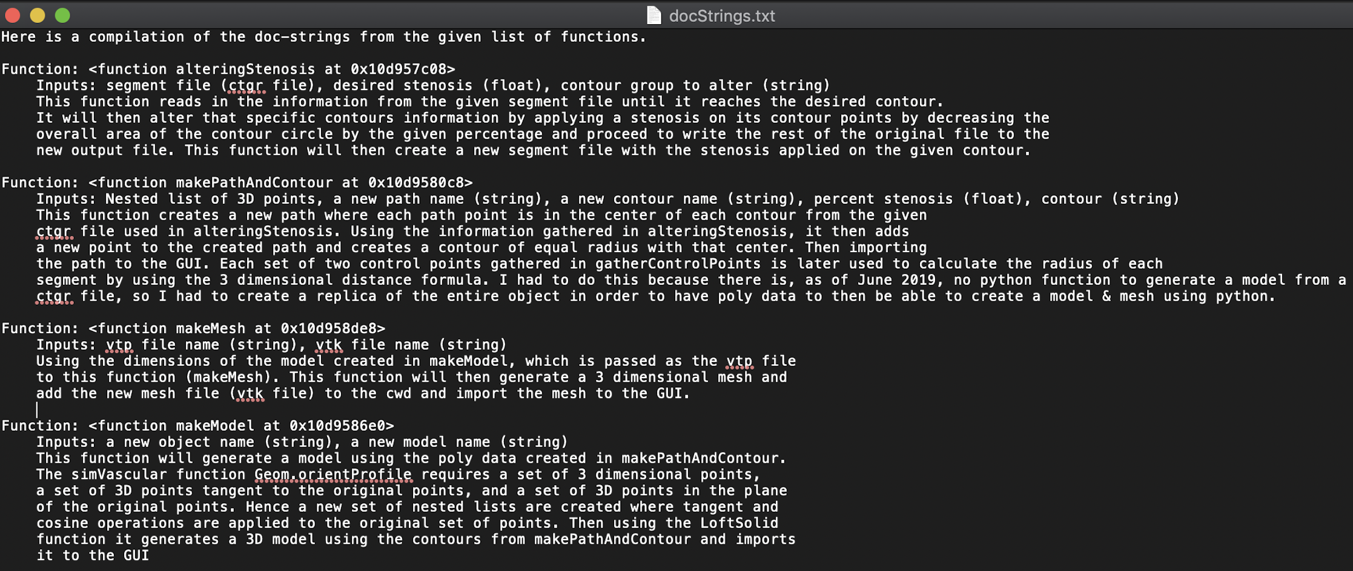
Docstrings
Added documentation to all developed functions
Can be parsed using my autoDoc function or external documentation functions (Sphinx)
Function
DocString

Slide 16
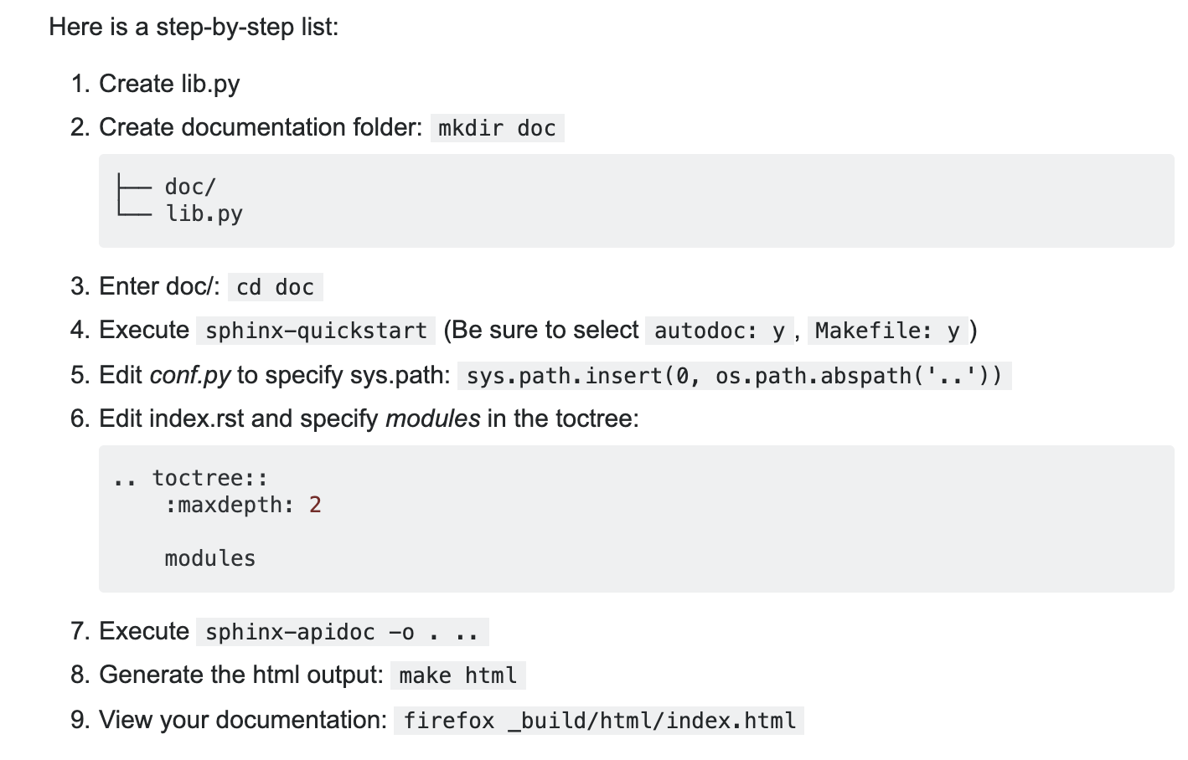
Sphinx Tutorial
Download sphinx
Ubuntu
apt-get install python3-sphinx
Linux
brew install sphinx-doc
Follow Tutorial

Slide 17
Git-Hub repo
https://github.com/TobiasJacobson/SimVascular-Scripting.git
Cylinder Model
genFi
Generates solver.inp and cylinder.svpre files
cylinderPipeline
Generates path points, contour, model, mesh, and runs the preSolver, svSolver and begins post processing
Coarct Model
coarctPipeline
Generates path, contour and model based on lists of 3D points and radii
Fontan Model
fontanStenosis
Alters given fontan segment file and creates a new one based on a given stenosis
Stenosis Pipeline
stenosisPipeline
Alters given segment file and creates a new one based on given stenosis
Using this new file it generates a path, contour, model, mesh, and runs the preSolver, svSolver, and begins post processing
Docstring Functions
autoDoc
Extracts docstrings from a given list of functions
Sphinx Tutorial

Slide 18
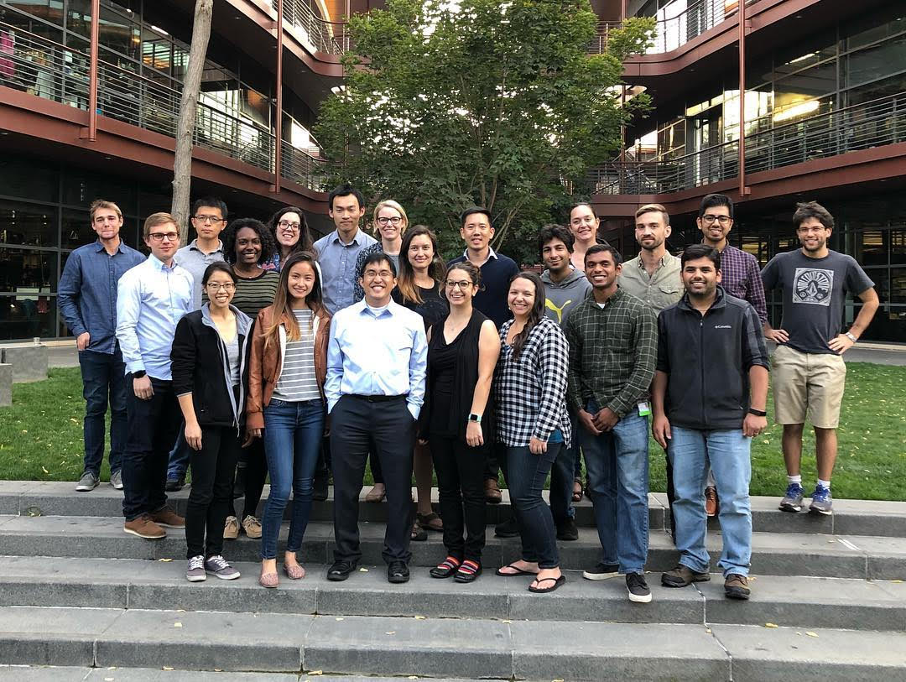
Thank You CBCL

